Slide 1

Building Reusable UI Components with RSF and Javascript
Antranig Basman,
CARET, University of Cambridge

Slide 2
Pattern of this Talk
Will proceed from server side, down to client side (mirroring historical development)
Explanation and demonstration of new RSF widgets (date picker, double select, rich text)
The Universal View Bus (UVB) for trivial AJAXification of components
Javascript programming styles and practice, and consideration of long-term issues raised by use of Javascript within Sakai (or any portal generally)

Slide 3
MFT
New in RSF 0.7 is support for “Multi-File Templates”
This is an unusually generic scheme which not only supports “widget” use cases but also of reusable page borders/central panels/really any kind of markup aggregation
In fact involves no real change to rendering algorithm
As Steve G. says, “suddenly any branch container becomes a candidate for reuse”
In practice, full reusability is constrained by requirement of unique naming on branches
RSF 0.7 solves this by introducing new component type UIJointContainer
  This is really just two UIBranchContainers joined together

Slide 4
IKAT Branching Rules
For a review of basic IKAT branch handling, see Steve Githens’ Café presentation
The core point is that encountering any branch tag (e.g. text-input: ) causes the renderer to momentarily consider the entire “resolution set” of all branch tags with the same prefix, in all templates, everywhere
The “best” match will be chosen, by a somewhat obscure algorithm – simpler to ensure that in general there is only one reasonable choice :)
A UIJointContainer allows you to “force” the issue by declaring a “forwarding” from one branch ID to another

Slide 5
UIJointContainer
public void fillComponents(UIContainer parent, String clientID) {
UIJointContainer joint = new UIJointContainer(parent, clientID, jointID);
nullaryProducer.fillComponents(joint);
}
client’s ID (appears in template that uses component)
joint ID (appears in template that implements component)
client ID
Select Date 1: <div rsf:id="date-1:">(Date control goes here)</div>
joint ID
<div style="margin: 5em">
<div rsf:id="date-field-input:">
<script rsf:id="datesymbols">

Slide 6
Producers and Evolvers
A “Producer” is the general term for a bean with method fillComponents which accepts a first argument UIContainer (possibly with some others)
Most familiar are standard “ViewProducers” from ancestral RSF
A very common pattern when developing reusable components is that the specification of “extra arguments” is most conveniently packaged in terms of a existing primitive RSF component (e.g. UIInput or UISelect)
This primitive component becomes called the “seed component”
The resulting producer becomes called an “evolver”

Slide 7
Using an Evolver
The most straightforward example of an evolver is for text input
The binding function of a Rich Text control, for example, is identical to that of standard UIInput
The client “prepares” for use of the RichTextEvolver by constructing the same UIInput he would for a standard HTML <input>, but after adding it to the tree, subsequently supplies it to an evolver:
Note that in this case the client must give the component a colon tag (ordinarily forbidden except for case of repetitive leaves)
RSF includes standard interfaces for the basic forms of Evolver
UIInput text = UIInput.make(cform, "rich-text:", "#{dataBean.text}");
textevolver.evolveTextInput(text);
public interface TextInputEvolver {
public UIJointContainer evolveTextInput(UIInput toevolve);
}

Slide 8
Implementing an Evolver
The first few lines of an evolver always follow the same pattern
  Construct a UIJointContainer
  Remove the seed component from its old parent
  Mutate the ID of the seed component to the required standard name (assuming it still appears in bare form in the new branch)
  Add the seed back into the new branch
For more complex evolvers (e.g. broken-up date input) the seed component may be used in a more complex fashion (e.g. steps 3 and 4 will not occur directly)
Better just copy an existing Evolver, the steps are easy to mix up (at least to me!)

Slide 9
Example: Rich Text Evolver (Sakai FCK)
public UIJointContainer evolveTextInput(UIInput toevolve) {
UIJointContainer joint = new UIJointContainer(toevolve.parent,
toevolve.ID, COMPONENT_ID);
toevolve.parent.remove(toevolve);
toevolve.ID = "input"; // must change ID while unattached
joint.addComponent(toevolve);
String collectionID = contentHostingService.getSiteCollection(context);
String js = HTMLUtil.emitJavascriptCall("setupRSFFormattedTextarea",
new String[] {toevolve.getFullID(), collectionID});
UIVerbatim.make(joint, "textarea-js", js);
return joint;
}
Note the use of J-ServletUtil’s HTMLUtil library to build up a simple Javascript call
More discussion later on Javascript initialisation strategies
Note in general that these utilities could be valuable with other view technologies also (even though we discard them chiz chiz)

Slide 10
Injecting an Evolver
Note that an Evolver is just a Spring bean satisfying a (very simple) interface, and since we are (probably) in the request scope, the actual choice of bean injected can be the result of an arbitrarily complex request-scope computation
  May take into account user preferences, accessibility requirements, hosting environment, etc.
<bean class="uk.ac.cam.caret.rsf.testcomponents.producers.IndexProducer">
...
<property name="dateEvolver1" ref="dateEvolver" />
<property name="textEvolver" ref="textEvolver" />
...

Slide 11
Swappable Implementations
This sort of configuration flexibility will form the basis of systems such as the UToronto Flexible UI Project
Note that we already have (at least) 2 layers of independent control
An interesting policy issue whether even these two layers should be administered as a single unit, or by distinct criteria...
Spring
injects
Producer
Spring
injects
Invokes
Evolver
Selects
JointID
Template

Slide 12
Part II
Planning for Intelligence on the Client
Richer clients will have more complex and interesting behaviours on the client side, and greater autonomy
Typically animated by Javascript
RSF follows a unique strategy of communicating to the client with its own bindings
Since it emits these in any case, often no modification or custom code is required at the server end
  Contrast these with uninterpretable Java monster blobs emitted to the client by other frameworks (assuming they bother to trust the client with anything at all)

Slide 13
Explaining to the Client
Sometimes the client needs a few extra clues
Requires deeper understanding of the RSF binding and request processing system
  All the same offers considerably more capability and genericity with much less work than other frameworks
Several new types of binding have been created in RSF just for client intelligencing

Slide 14
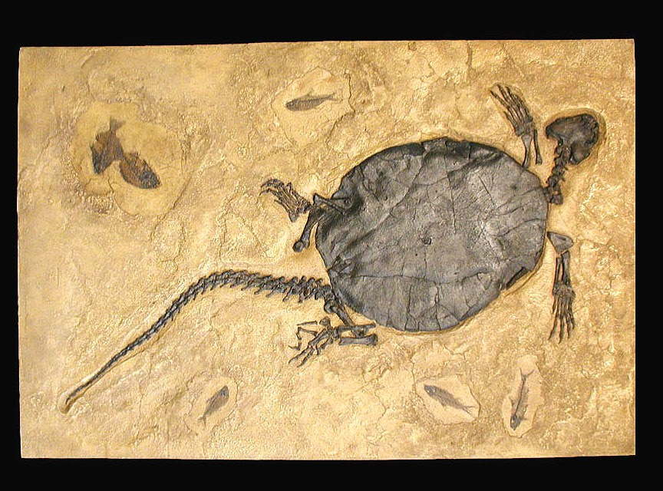
Bindings in RSF
Bindings may be attached to a form as a whole, or just to individual submitting controls
Bindings are encoded on the client in a completely transparent form (“fossilized”)
Rather than a heap of base-64 encoded Java blobs, they are simple collections of Strings (key/value pairs)
Can be manipulated by Javascript and AJAX to create extremely dynamic UIs
Note: Another approach to the client side is an AHAH-like auto-portalised system. Probably work for post-1.0

Slide 15
Binding types
Two principal types of RSF bindings
  Fossilized bindings attached to submitting HTML controls
    “Shadow” their submission and inform RSF of their target in the model and value type
  EL bindings, which are pure model operations to act “in the future”.
    Either “pure EL” bindings, which just perform an EL assignment “lvalueEL = rvalueEL” or
    ones which add or remove encoded values from the model
key = componentid-fossil, value=[i|j|o]uitype-name#{bean.member}oldvalue
key = [deletion|el]-binding, value = [e|o]#{el.lvalue}rvalue

Slide 16
Dealing with bindings
Luckily the user now never has to deal with bindings (for reference their handling is centralised in FossilizedConverter.java)
The core parsing and invalidation algorithms have been ported into Javascript (!!) as part of rsf.js
This allows the client to deduce the effects of a form based on its fossilized encodings (more about this later)

Slide 17
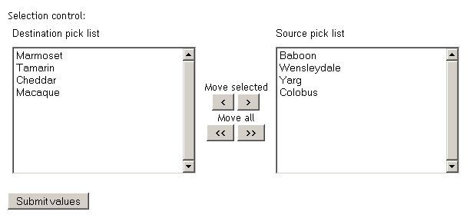
Explaining to the client (in practice)
Gonzalo’s Double Chooser is a great example of a moderately complex control
Basic Javascript was attached to Gonzalo’s markup to allow it to operate unattended in the filesystem (previewability of behaviour as well as appearance)
Going the rest of the way to a server component requires the elements to be connected to the model via bindings

Slide 18
Interesting Gonzalish Aspects
The values which will submit are the ones that are in the left-hand control
However, these may NOT arise as part of a natural HTML submission!
Any values which *would* submit from the selection would be ones that would arise through a user-misclick or leaving some left values selected
The right control is completely non-submitting and should be marked as render-only:
UISelect rightselect = UISelect.makeMultiple(togo, "list2",
rightnames.toStringArray(),
toevolve.selection.valuebinding.value, null);
rightselect.optionlist = UIOutputMany.make(rightvals.toStringArray());
rightselect.selection.willinput = false;
rightselect.selection.fossilize = false;

Slide 19
Dealing with the left selection
Unfortunately, if we mark the left control as non-submitting, RSF will not emit either a name or a fossil for it
The fossil must in fact be “hijacked” by the client-side Javascript, which will fabricate hidden <input> fields to simulate the submission that would have resulted from the equivalent multiple select
This “fabricated submission” will then be directed by RSF at the correct value in the model supplied in the seed
Therefore, the JS is autonomously entrusted with two missions:
  Disable natural submission of left select (by deleting “name” attr)
  Dynamically fabricate/remove hidden <input> fields to mirror contents of left selection, as the user clicks around

Slide 20
Some Javascript
init_DoubleList: function(nameBase) {
var container = $it(nameBase);
var leftSel = $it(nameBase + "list1-selection");
var rightSel = $it(nameBase + "list2-selection");
var submitname = leftSel.getAttribute("name");
removeAttribute(leftSel, "name");
Illustrates key strategy in building widgets – the UIBranchContainer holding the jointID is treated as a naming base in order to locate all the client-side subcomponents
As a result of the RSF Full ID algorithm
public UIJointContainer evolveSelect(UISelect toevolve) {
UIJointContainer togo = new UIJointContainer(toevolve.parent, toevolve.ID,
COMPONENT_ID);
toevolve.parent.remove(toevolve);
...
UISelect leftselect = UISelect.makeMultiple(togo, "list1",
leftnames.toStringArray(), toevolve.selection.valuebinding.value, null);
leftselect.optionlist = UIOutputMany.make(leftvals.toStringArray());
...
String initselect = HTMLUtil.emitJavascriptCall(JSInitName,
new String[] {togo.getFullID()});
UIVerbatim.make(togo, "init-select", initselect);

Slide 21
Javascript issues
Sakai is a uniquely challenging environment for Javascript (as is any portal)
The issues are basically ones of name collisions, but considerably exacerbated since Javascript is a crazed language that allows one to assign to language primitives such as Object.prototype and Array.prototype
Need to carefully select libraries for mutual compatibility
Libraries situation is a seething tumult and changing every day

Slide 22
Javascript coding observations
Javascript is the greatest undetected jewel in the browser universe (no, really!)
The “Object-Oriented” features are an botch forced by dogmatism onto an already complete language
A central preoccupation of most libraries is getting the “this” reference to momentarily coincide with something relevant
  My advice – don’t bother
  Treating plain functions (1st-order and higher) is a great approach to ensuring name isolation and allowing code reuse
  It is also a lot of fun

Slide 23
Namespacing in Javascript
The first of the essential issues to be tackled in aggregating JS in a portal environment
Like everything else in Javascript, best done in terms of function()s!
// RSF.js - primitive definitions for parsing RSF-rendered forms and bindings
// definitions placed in RSF namespace, following approach recommended in
// http://www.dustindiaz.com/namespace-your-javascript/
var RSF = function() {
function invalidate(invalidated, EL, entry) {
... other private definitions here
...
return {
addEvent: function (element, type, handler) {
... other public definitions here (both “methods” and “members”)
...
}; // end return internal "Object"
}(); // end namespace RSF

Slide 24
Javascript startup approaches
A core and perennial issue is how to package initialisation code on the client side
Two main approaches
  An onload handler which trawls over the document, probably driven by CSS classes, initialising for components it recognises
  An explicitly rendered <script> tag in the document body which initialises a local component

Slide 25
Javascript startup issues
Gaining access to onload in different environments (esp. portals) may be error-prone, and also mandates a specific onload aggregation strategy (and hence possibly choice of JS framework)
<script> body tags are globally criticised on formal grounds. However they DO work portably
onload scheme will probably also be a lot slower, especially as page size and number of widgets increases
For RSF, for now, I have chosen the <script> option
Good practice is to slim down this init code as much as possible (a single function call)
To make this easy, there is standard utility emitJavascriptCall in PonderUtilCore:
String js = HTMLUtil.emitJavascriptCall("setupRSFFormattedTextarea",
new String[] {toevolve.getFullID(), collectionID});
UIVerbatim.make(joint, "textarea-js", js);

Slide 26
Choices on the Client Side
Prototype.js
  Influenced by (generated by) Ruby
  Lots of “functional” tricks
  Has spawned a whole tree of dependent libraries (rico, scriptaculous, etc.)
  Is pretty darn rude since it assigns to all sorts of JS primitives
  Is *probably* unacceptable for widespread use in Sakai, although sufficiently widespread that compatibility is not a dead loss
Yahoo UI Library
  Written by “grownups” – all properly namespaced
  Lots of useful widgets and libaries
  Is pretty bulky and clunky
  Is certainly safe for Sakai

Slide 27
Choices on the Client Side II
DOJO
  Supported by IBM and others
  Again has many widgets
  Currently preferred choice of UToronto
  Don’t know much about it myself
JQuery
  Interesting “continuation” style of invoking
  Cross-library safety needs to be vetted
  Over to Josh!

Slide 28
Implementation of the Date Widget
Key strategy is to leverage Java-side comprehensive information on Locales
Huge variety of date formats made a simpler initial strategy to do all date conversion on the server via AJAX
  This implementation work is “amortised” by creation of UVB, an AJAX view and client-side code that can be used for ALL RSF components
A more efficient approach to port some of this logic to Javascript
  However this would make the algorithms less testable and maintainable
Package components in as tech-neutral manner as possible
Since

Slide 29
Java Dates – Step 1
Extract all relevant Locale info from JDK DateFormatSymbols
This logic is part of PonderUtilCore’s DateSymbolJSEmitter, easy to use in other view techs
String jsblock = jsemitter.emitDateSymbols();
UIVerbatim.make(togo, "datesymbols", jsblock);
<script rsf:id="datesymbols">
//<![CDATA[
// These are the date symbols for en_ZA
PUC_MONTHS_LONG = ["January", "February", "March", "April", "May", "June", "July", "August", "September", "October", "November", "December"];
PUC_MONTHS_SHORT = ["Jan", "Feb", "Mar", "Apr", "May", "Jun", "Jul", "Aug", "Sep", "Oct", "Nov", "Dec"];
PUC_WEEKDAYS_LONG = ["Sunday", "Monday", "Tuesday", "Wednesday", "Thursday", "Friday", "Saturday"];
PUC_WEEKDAYS_MEDIUM = ["Sun", "Mon", "Tue", "Wed", "Thu", "Fri", "Sat"];
PUC_WEEKDAYS_SHORT = ["Su", "Mo", "Tu", "We", "Th", "Fr", "Sa"];
PUC_WEEKDAYS_1CHAR = ["S", "M", "T", "W", "T", "F", "S"];
PUC_FIRST_DAY_OF_WEEK = "0";
PUC_DATE_FORMAT = "yy/MM/dd";
PUC_DATETIME_FORMAT = "yy/MM/dd hh:mm";
PUC_TIME_FORMAT = "hh:mm";
//]]>
</script>

Slide 30
Java Dates – Step 2
FieldDateTransit is a “Swiss Army Knife” of date conversion functions for a particular Locale
Again, is a “POJO” and is technology-neutral, although has a special role within RSF
public interface FieldDateTransit extends LocaleSetter {
public void setTimeZone(TimeZone timezone);
public String getShort();
public String getMedium();
public String getLong();
public String getTime();
public String getLongTime();

Slide 31
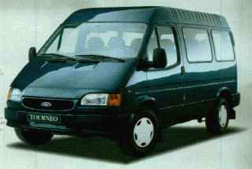
Transit Beans
Transit Beans are kinds of POJO that do the work of converting data from one form to another
Since the data has been altered, must be given a distinct name in the request scope (part of BeanReasonableness)
Is a kind of OTP (see this morning’s talk) – but rather than being a window onto server-side state, each transit instance starts off in the same state
Similar to Validation POJOs – but those act “in place” at one part of the request model

Slide 32
Configuring Transit Beans
Configured using a standard “beanExploder” parent definition
“Explodes” a single bean definition (or factory) into an infinite “lazy address space” of identical instances – for example #{fieldDateTransit.1} , #{fieldDateTransit.xxx} etc. are all paths to different instances
Is the key to RSF’s ZSS (Zero Server State) solution in more advanced cases – allows each instance of the date widget to pre-allocate its own distinct “variable” in the forthcoming request scope
<bean id="fieldDateTransit" parent="beanExploder">
<property name="factory">
<bean class="uk.org.ponder.dateutil.StandardFieldDateTransit"
init-method="init">
<property name="locale" ref="requestLocale" />
<property name="timeZone" ref="requestTimeZone"/>
</bean>
</property>
</bean>

Slide 33
Explaining to the client II
In this case, the date widget implementation uses its own namebase (in component space) as the unique name for its expected transit
Guarantees multiple simultaneous submissions will not interfere
public UIJointContainer evolveDateInput(UIInput toevolve, Date value) {
UIJointContainer togo = new UIJointContainer(toevolve.parent, toevolve.ID,
COMPONENT_ID);
...
String ttbo = transitbase + "." + togo.getFullID();
...
String ttb = ttbo + ".";
...
ViewParameters uvbparams = new SimpleViewParameters(UVBProducer.VIEW_ID);
String initdate = HTMLUtil.emitJavascriptCall(JSInitName,
new String[] {togo.getFullID(), title.get(), ttb,
vsh.getFullURL(uvbparams)});
UIVerbatim.make(togo, "init-date", initdate);
return togo;
}

Slide 34
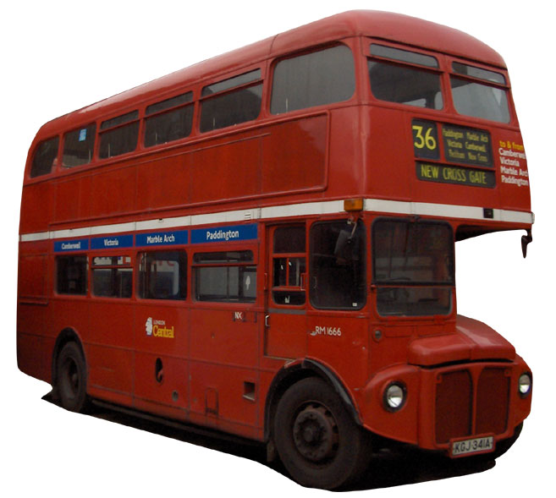
UVB
The Universal View Bus is
a built-in RSF view suitable
for “any” AJAX component
  at least any one which uses “semantic” AJAX as opposed to AHAH
Can be thought of as an auto-derived web service based on your application’s structure
<?xml version="1.0" encoding="UTF-8"?>
<root>
<value rsf:id=":">Value</value>
<value rsf:id="tml:">message</value>
</root>

Slide 35
UVB Goals and Requirements
Key approach to “adjustable thickness clients” – whilst RSF application works normally as Web 1.0, “live” features can be dynamically added and removed based on client capabilities, without requiring any extra server-side coding
Enables a “flexible UI” – see Toronto’s FLUID project
UVB generally requires a use of OTP/transit beans
The application’s data model and services must be exposed in an address space of EL

Slide 36
Using RSF.js
In one step, submit any number of controls, and read back any number of bindings
sourceFields argument allows “Partial Form Submission” (PFS) of any number of RSF controls (even from different forms)
Almost as short as “dummy” implementation for previewing
return RSF.getAJAXUpdater(sourceFields, AJAXURL, bindings,
function(UVB) {
var longresult = UVB.EL[longbinding];
var trueresult = UVB.EL[truebinding];
// use bindings results here

Slide 37
What else is in RSF.js
As well as factored out UVB/PFS utilities, contains event and invalidation management logic
Client-side widgets form a local MVC pattern – which is where MVC belongs!
Keeping track of event propagation across AJAX call boundaries can be awkward – RSF.js contains “getModelFirer” and “addElementListener” that cooperate with its AJAX manager

Slide 38
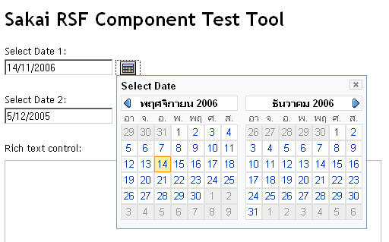
RSF Internationalised Date Widget
Leverages JDK I18N information to produce a universally internationalised widget on the client side
Continues with RSF strategy of previewable behaviour and presentation in the filesystem
Uses both UVB strategy and RSF.js event propagation to keep implementation Javascript to a minimum
Each HTML control (boxed) peers with a unique Server EL (black text/arrows – see next slide), for complete JS transparency
date-container
time-field
date-field

Slide 39
Date widget local and remote structure
short
long
date
longTime
time
date-annotation
time-annotation
date-container
date-field
time-field
true-date
“Model”
Optional Fields
= event-driven value update propagation
= user input can originate at this component
local name
= HTML field, full HTML id is derived by
extension from namebase, e.g. namebase + “true-date”
binding
= OTP/UVB server binding, full EL binding is derived by
extension from transitbase, e.g. transitbase + “longTime”

